Slide 1
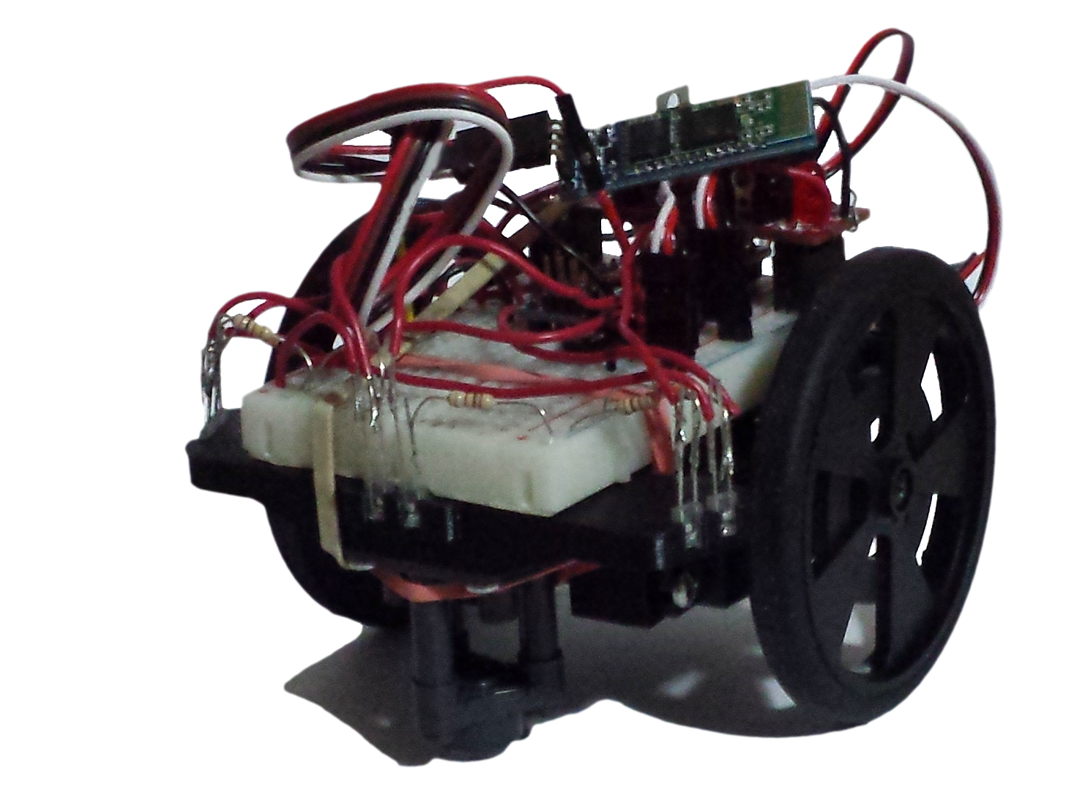
Nanomouse
Group Members: Jason Nixon, Mohammad Sameeh, Guillermo Fabian

Slide 2
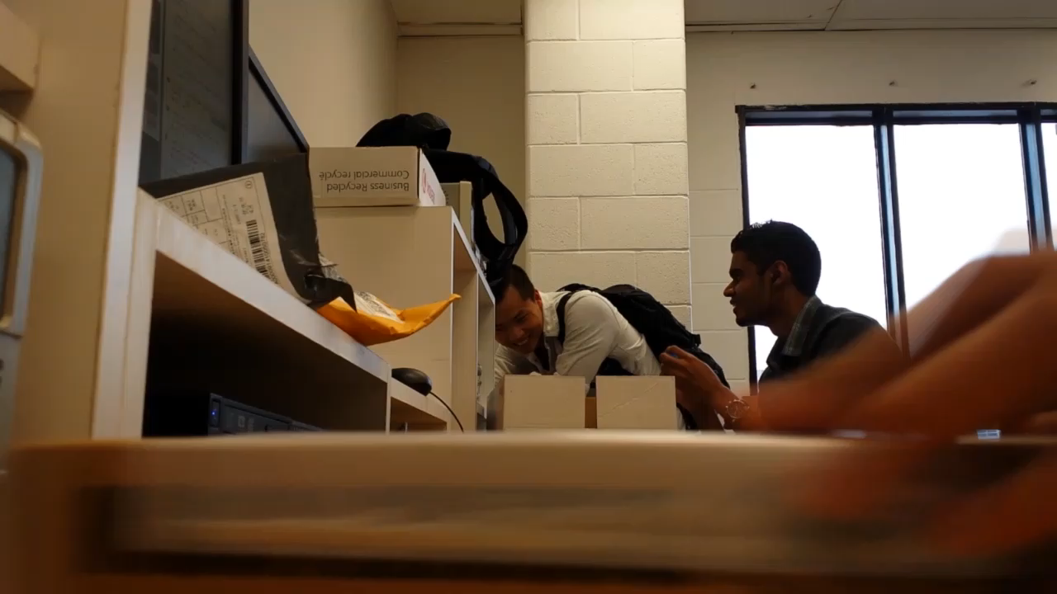
Introduction - Hardware Production

Slide 3
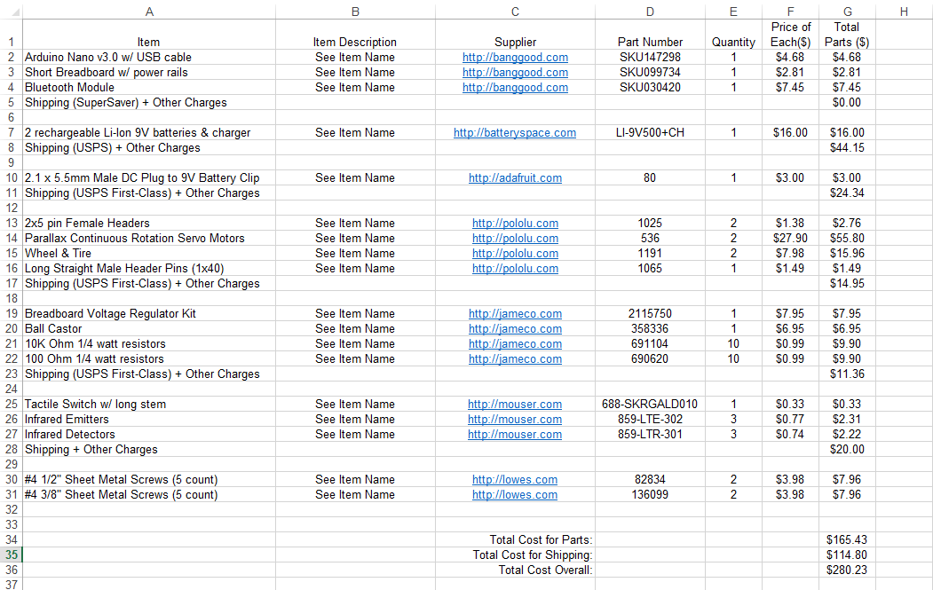
Project Bill of Materials

Slide 4
Algorithm – Placeholder 1

Slide 5
Algorithm – Placeholder 2

Slide 6
Algorithm – Placeholder 3

Slide 7
Database – Placeholder 1

Slide 8
Database – Placeholder 2

Slide 9
Database – Placeholder 3

Slide 10
Application – Placeholder 1

Slide 11
Application – Placeholder 2

Slide 12
Application – Placeholder 3

Slide 13
Conclusion

